Slide 1
Green Schoolyards
for Better Health & Learning
Notes:
Potential talking points:
-The number of green schoolyards is growing as communities come together to transform asphalt and turf grass into enriching outdoor areas where children and families can learn, play and grow both during and outside of school time.
-Schools are safe community centers that can provide daily access to the benefits of nature for children & communities
-A growing body of evidence shows that time spent learning and playing in nature can help children reach their full academic and social-emotional potential. Regular access to high quality green space improves mental and physical health — and inspires strong connections to the natural world.

Slide 2
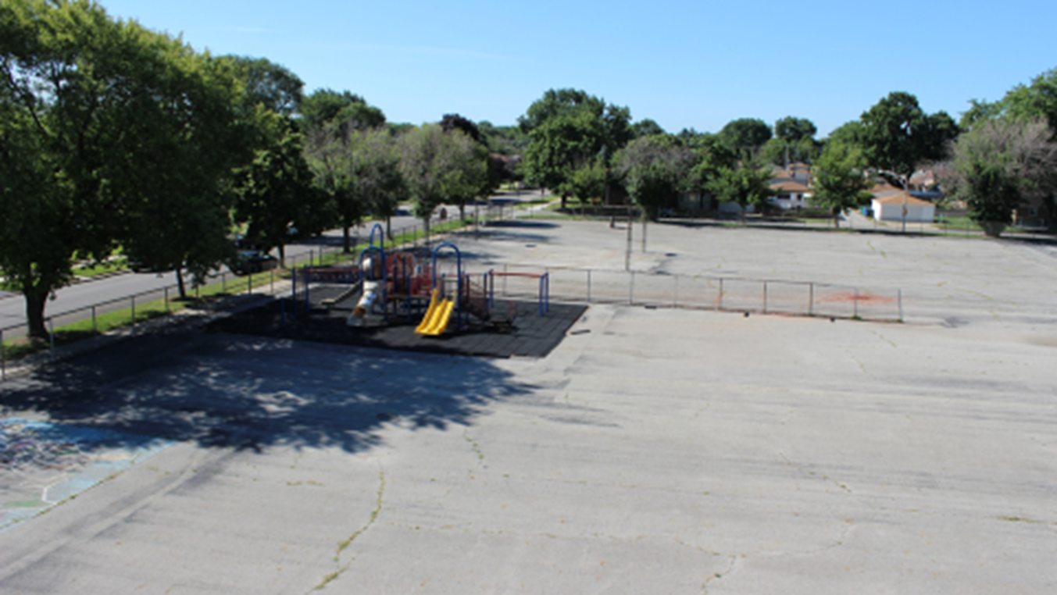
The state of schoolyards today:
One word: ASPHALT
Not enough play area to engage all children during recess and PE
Not designed for hands-on learning outdoors
Does not excite, motivate kids to want to come to school
Lack of green space= increased temps outside & higher cooling costs inside the school
Asphalt replacement and repair costs
Increased costs for snow plowing
Increased flooding & inability to use the space for periods of time
Notes:
-This is what most schoolyards look like today – a sea of asphalt or grass with a piece of playground equipment plunked down. These spaces are costly to schools and school districts….
-Choose a few of these bullet points to highlight that will speak to your audience.
-This is a before picture of a Space to Grow: Greening Chicago Schoolyards school on the far southeast side of Chicago

Slide 3
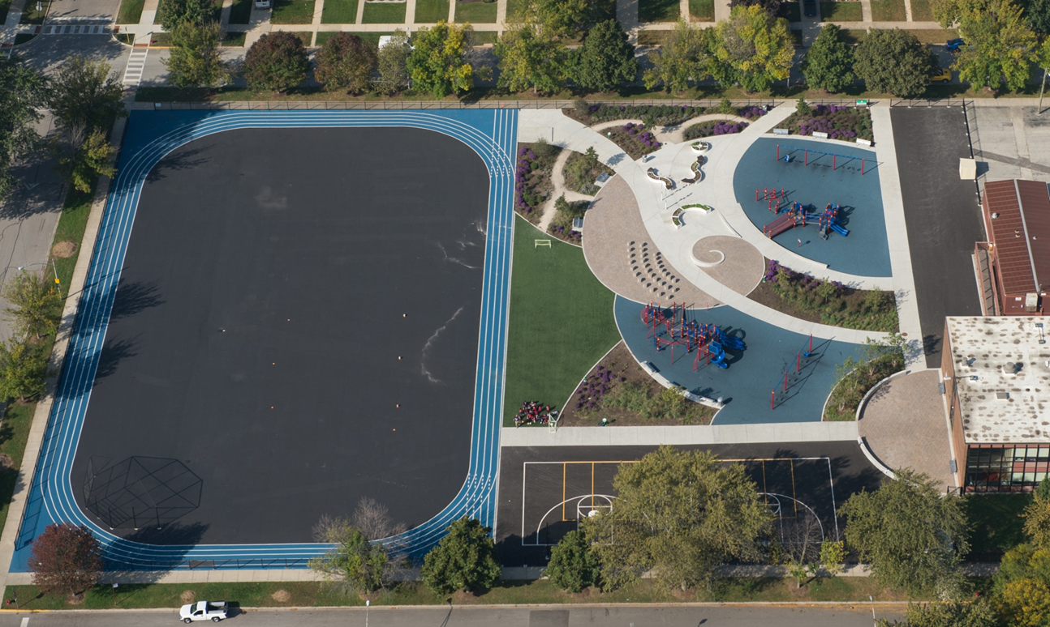
The potential of green schoolyards
Ample play area to engage more children during recess and PE for increased physical activity
Outdoor classrooms areas for hands on learning help meet Environmental Literacy Plan goals
Reduction in stress levels, enhanced mental health
Improvements in academic performance
Increase in enrollment
Increased student attention and attendance
Increase in family and community engagement
Lower energy costs for cooling buildings
Reduction in schoolyard and local area flooding
Schoolyard is available for use throughout the year and in different weather conditions
Notes:
-But schoolyards can be so much more.
-Choose a few of these bullet points to highlight that will speak to your audience.
-This after picture of the same schoolyard includes stormwater capture, an outdoor classroom, age-appropriate playgrounds, edible and pollinator gardens, trees, and areas for physical activity.

Slide 4
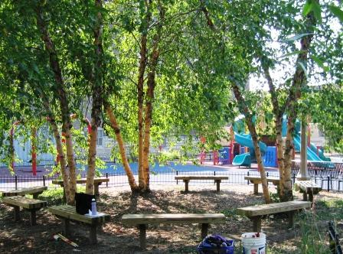
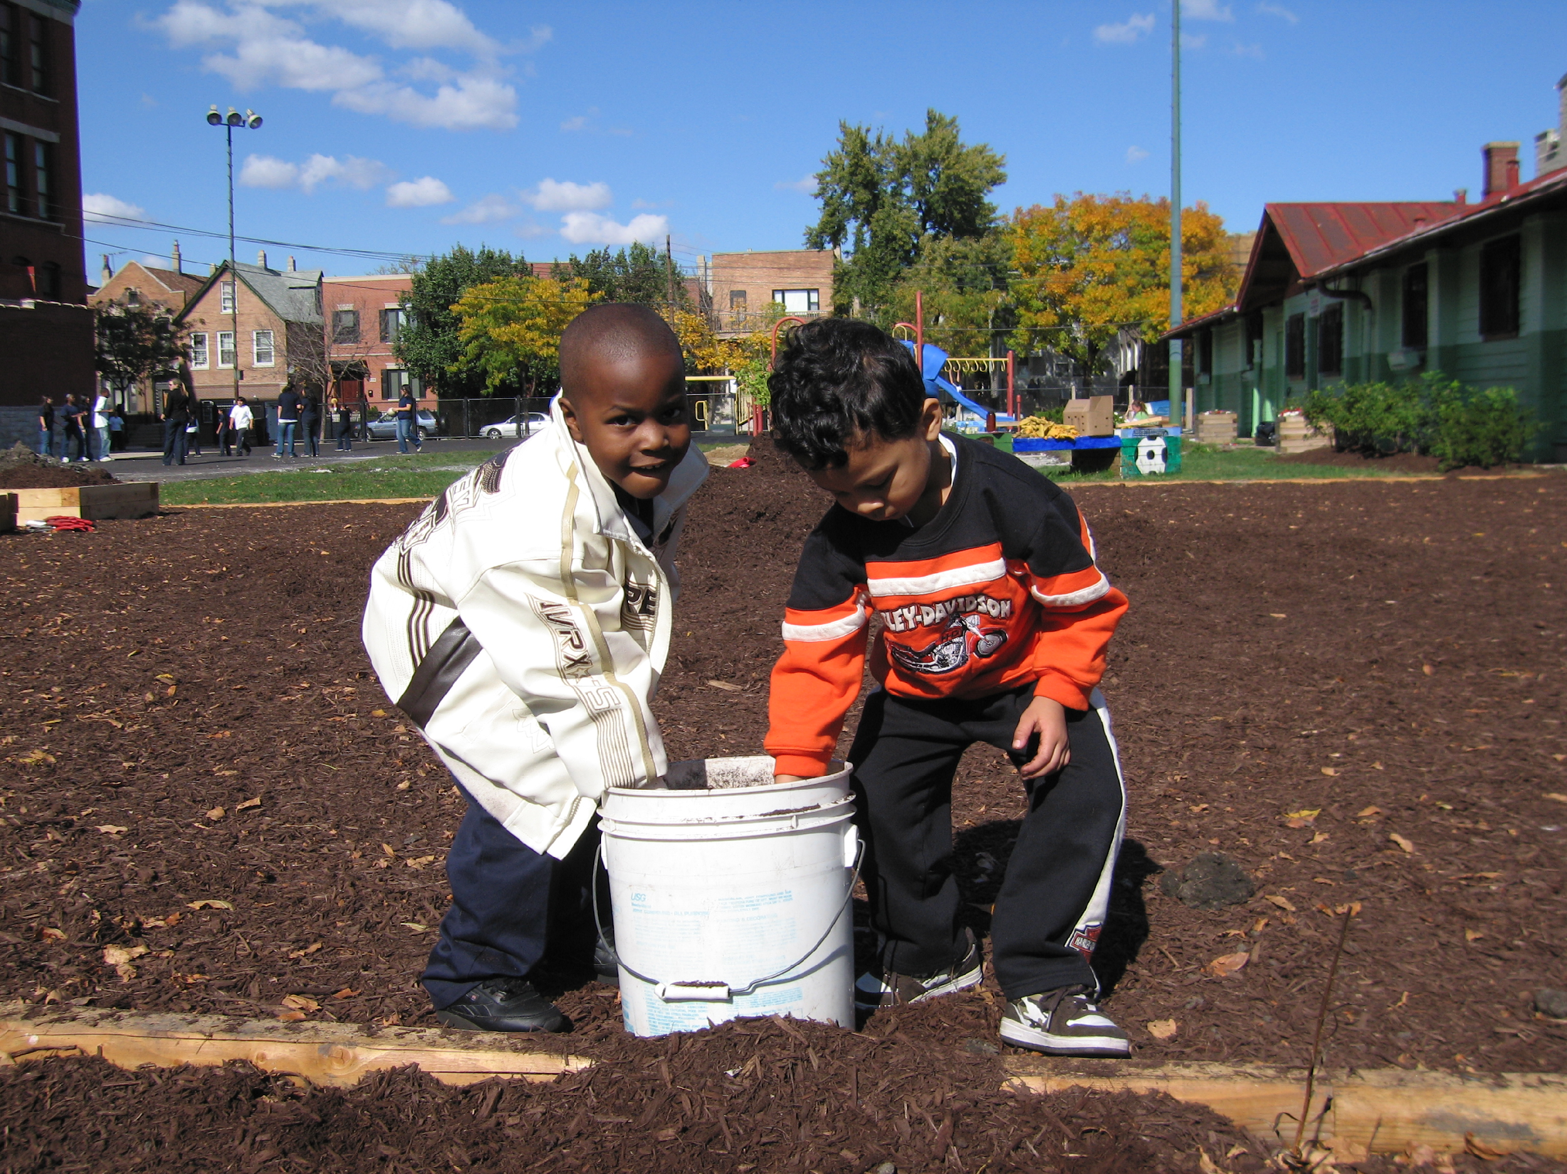
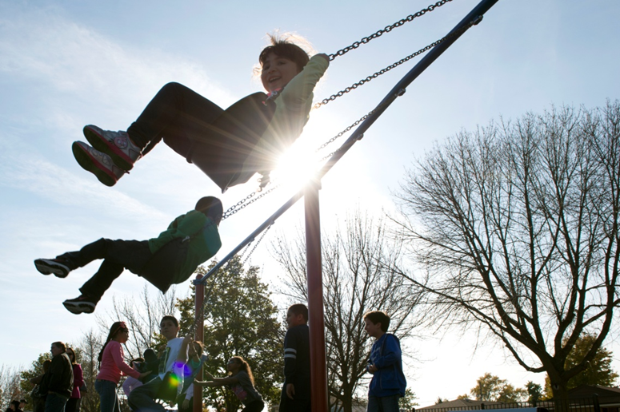
What are green schoolyards?
The Children & Nature Network defines green schoolyards as multi-functional school grounds designed for and by the entire school community.
Green schoolyards include places for students, teachers, parents and community members to play, learn, explore and grow.
Green Schoolyards can include:
Outdoor classrooms
Native and pollinator gardens
Storm water capture
Traditional play equipment
Nature play areas
Edible gardens
Trails and walking paths
Trees, shrubs and more
During out of school time, green schoolyards are ideally open for community use.

Slide 5
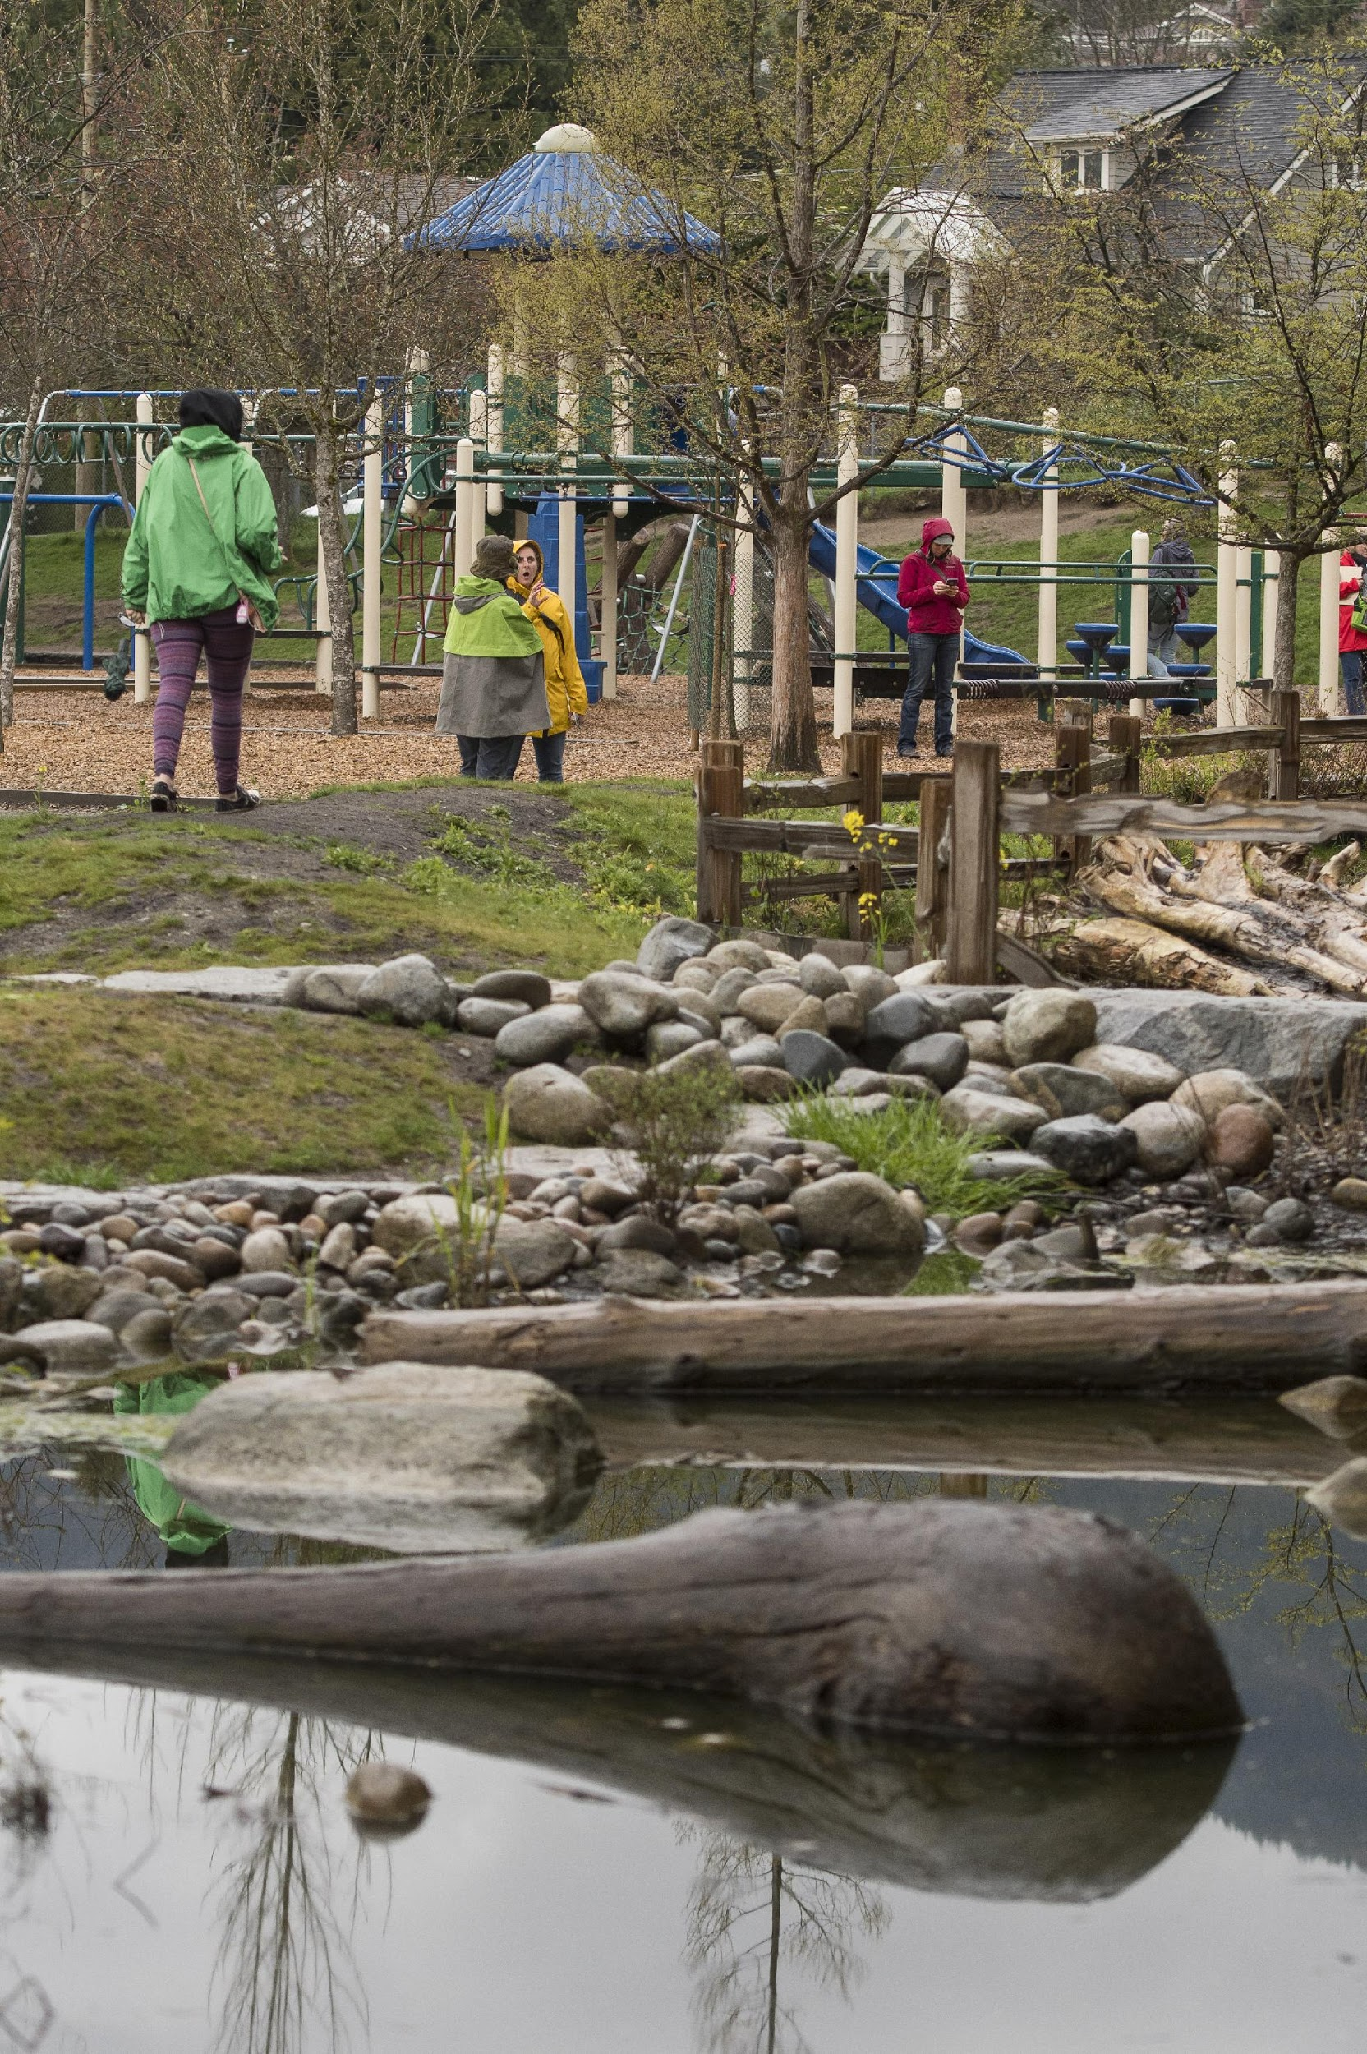
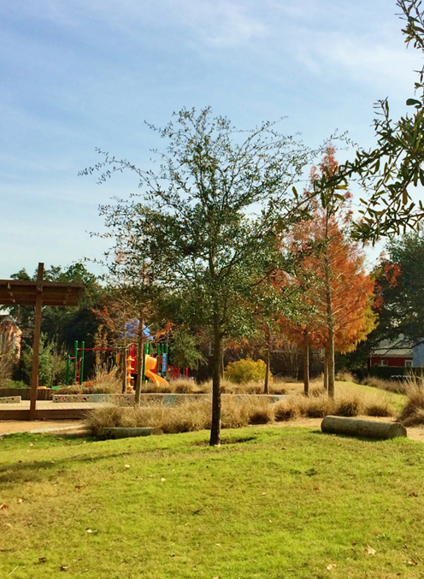
What if all schoolyards were green schoolyards?
Vancouver, Canada
SPARK! Houston, TX
Notes:
(Feel free to add in photos from your community to make this more relevant.)
How can we ensure that all students and community members have access to green schoolyards in our district?

Slide 6
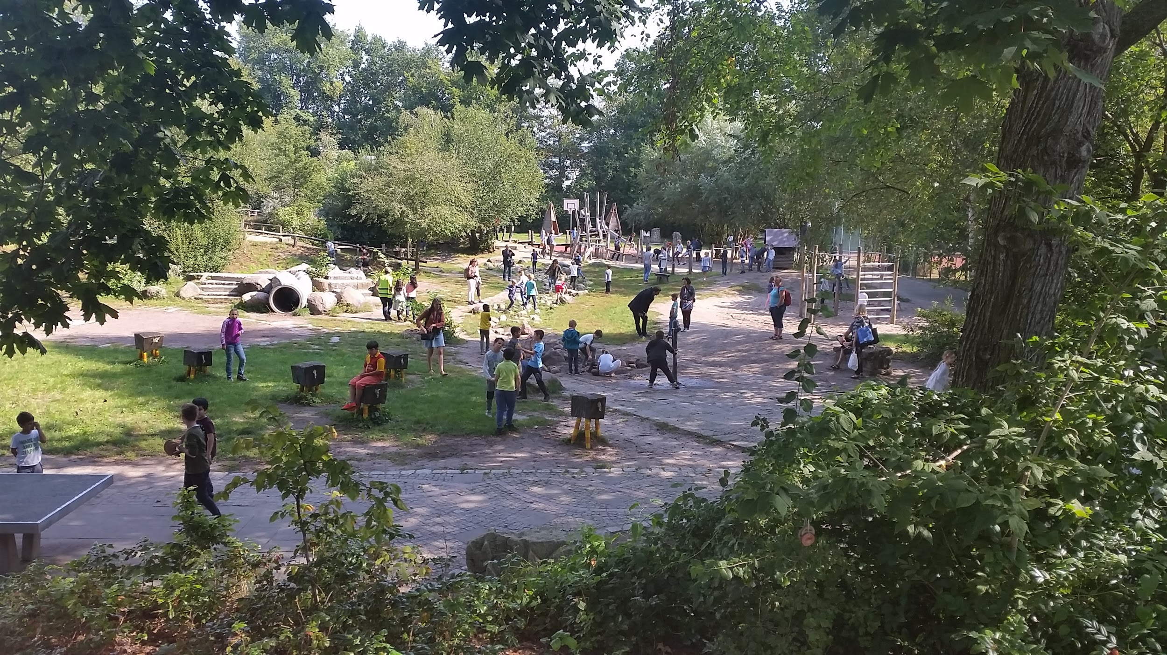
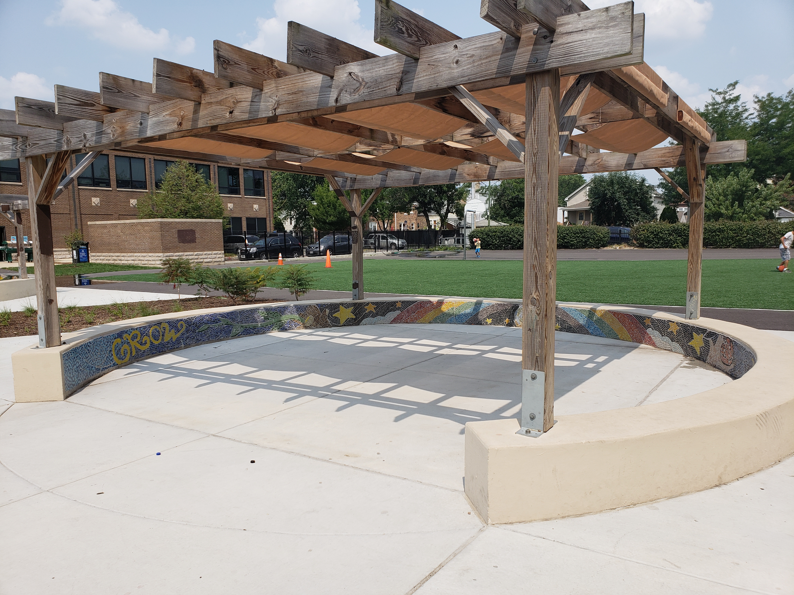
How would you feel if this was your schoolyard?
Grun Macht Schule, Berlin, Germany
Openlands, Chicago

Slide 7
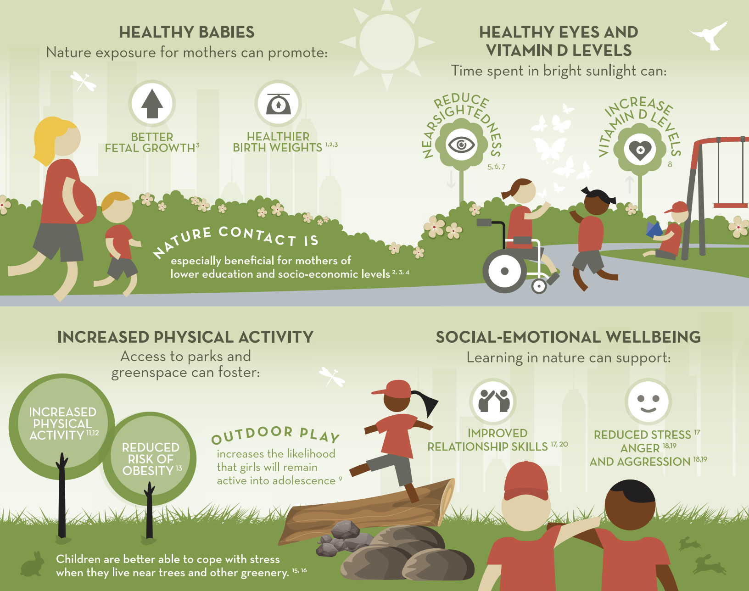
Nature can improve health & wellbeing
Spending time in nature provides children with a wide range of health benefits.
Infographic available at www.childrenandnature.org

Slide 8
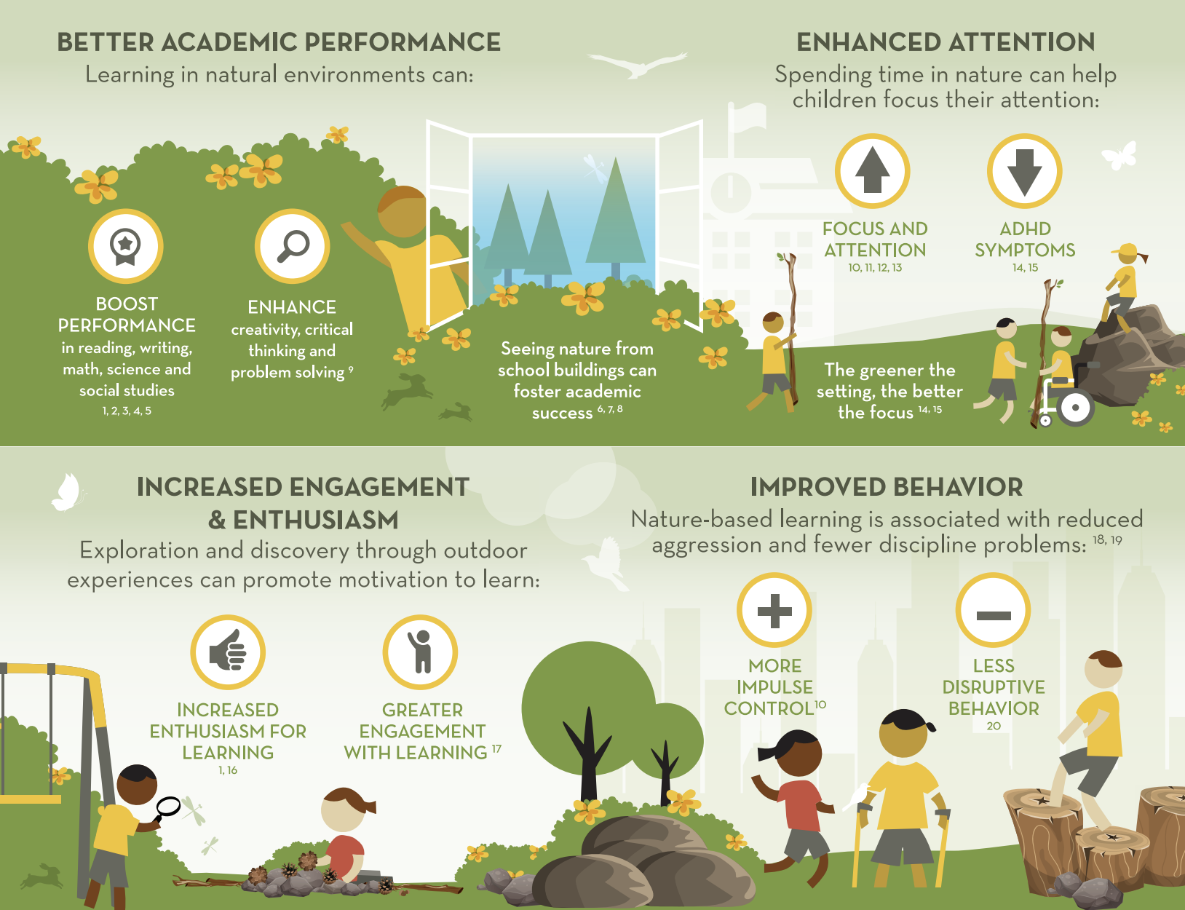
Nature can improve academic outcomes
Spending time in nature improves educational
outcomes by enhancing academic performance, focus, behavior and love of
learning.
Infographic available at
childrenandnature.org

Slide 9
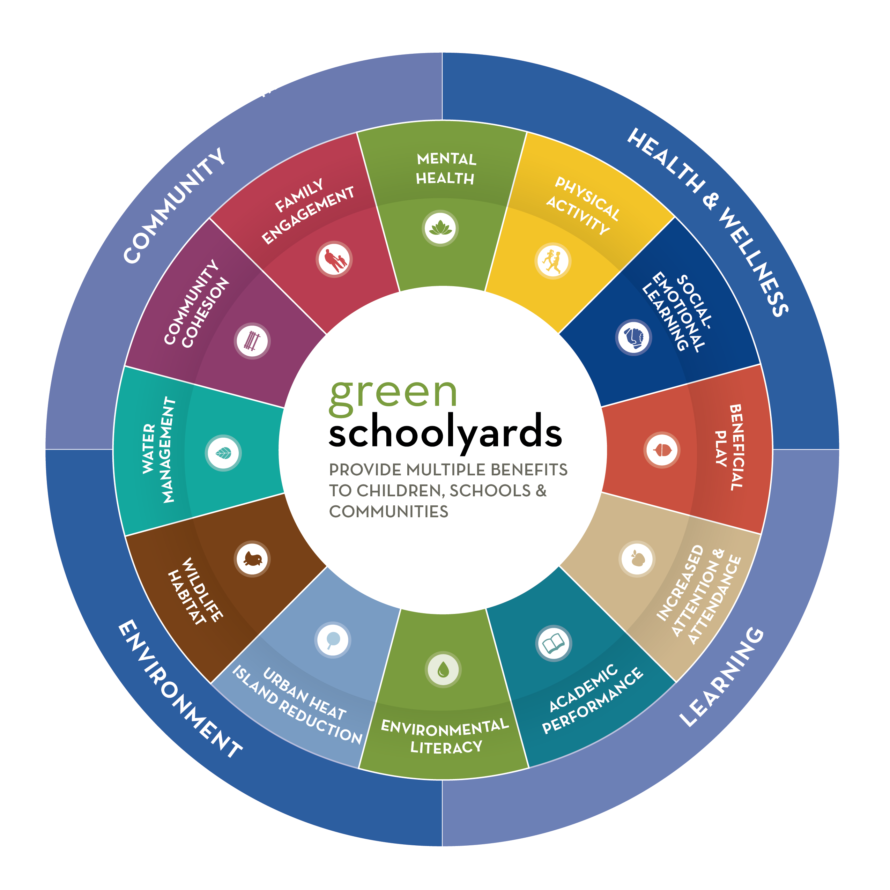
Benefits of Green Schoolyards
Notes:
-Use this graphic to talk about audience priorities that can be met through green schoolyards. What are they focused on? SEL? Attendance? Mental Health?
-All of these things and more can be supported by greening schoolyards in your community.
-Partners and funders can be brought to the table based on their interests in any of these benefits.

Slide 10
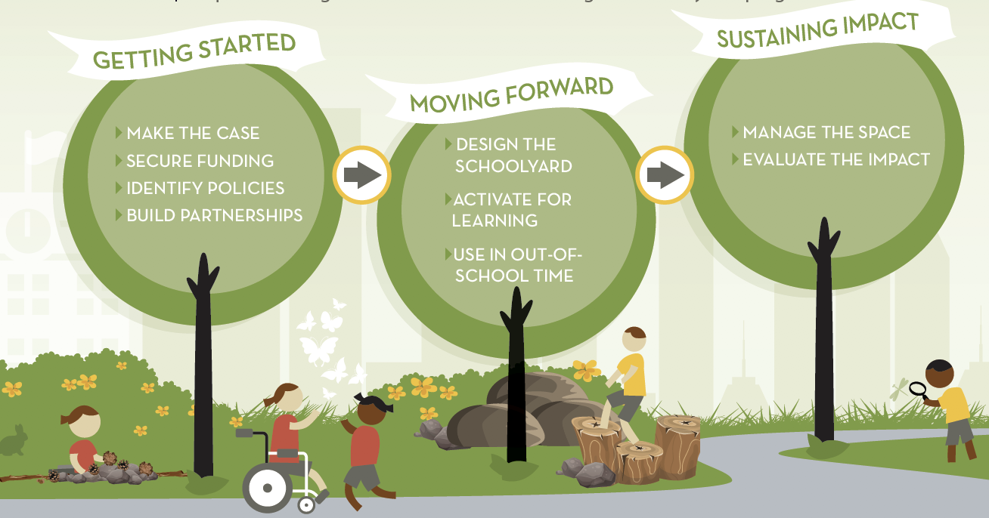
Building & sustaining green schoolyards
Notes:
-It isn’t enough to just build a new schoolyard, though. Once there is support, funding and policy for starting a green schoolyards program in your community, many things will need to be considered, such as the Implementation and Sustaining sections of this graphic.
-Highlight the areas that you think that your audience might not be considering.

Slide 11
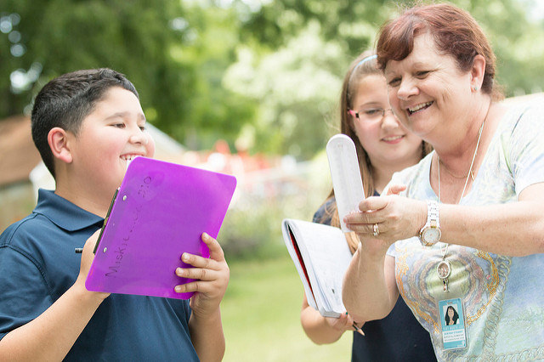
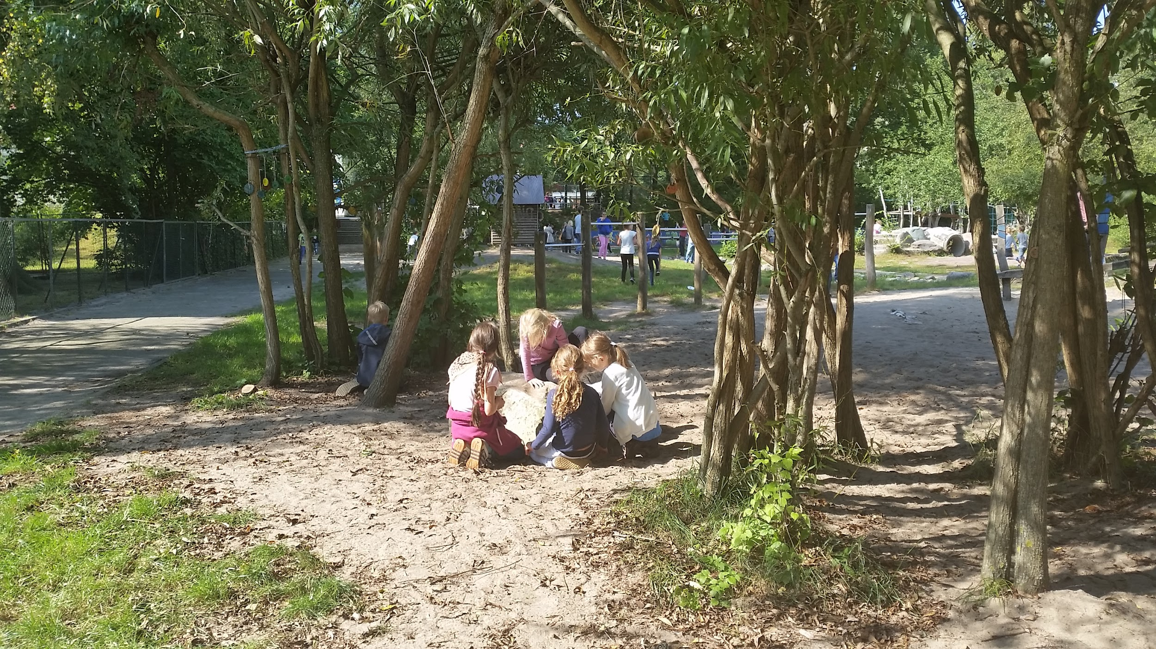
Using green schoolyards as outdoor classrooms
Education Outside
OutTeach
With a few tools and some training, there is no limit to what can be taught outside...
Grun Macht Schule
Notes:
-Many states have Environmental Literacy Plans or requirements, and Next Generation Science Standards require hands on outdoor learning.
-While new curriculum isn’t necessary, teachers do need to feel comfortable with taking their class outside to teach in a different setting. Consider partnering with a local non-profit that may be skilled in leading staff development around classroom management outside and helping assess what can be taught inside or outside!

Slide 12

Just about anything can be taught outside….
…and in doing so, green schoolyards:
Improve mental health by enhancing mood and decreasing stress for better learning;
Increase cognitive function and performance on standardized tests through improved focus, attention and executive function both during and after outdoor learning
Enhance social-emotional functioning and pro-social and cooperative behaviors.
Openlands, Chicago
Notes:
-There are more benefits to learning and playing outside than just what happens during that time. The short and long-term outcomes are incredible for individuals, classes and schools.

Slide 13
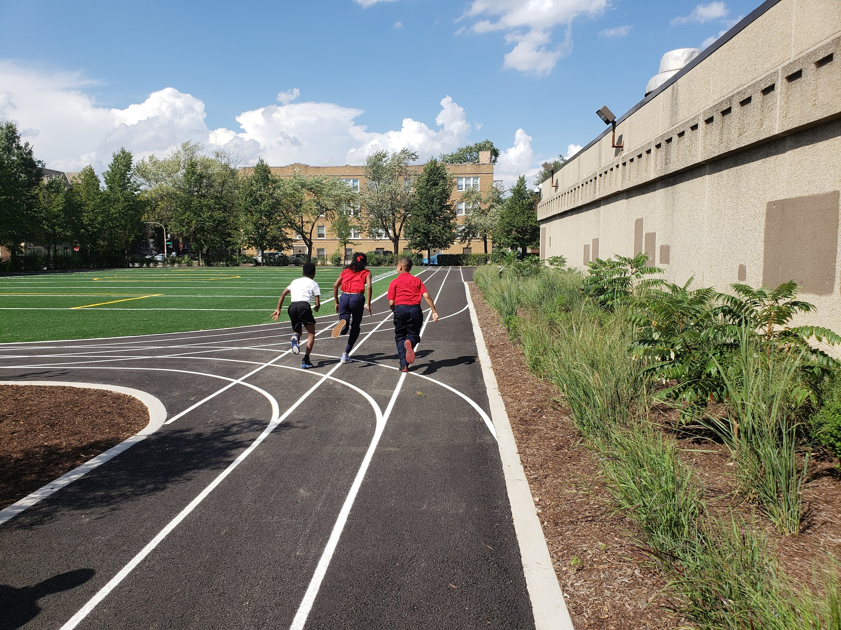
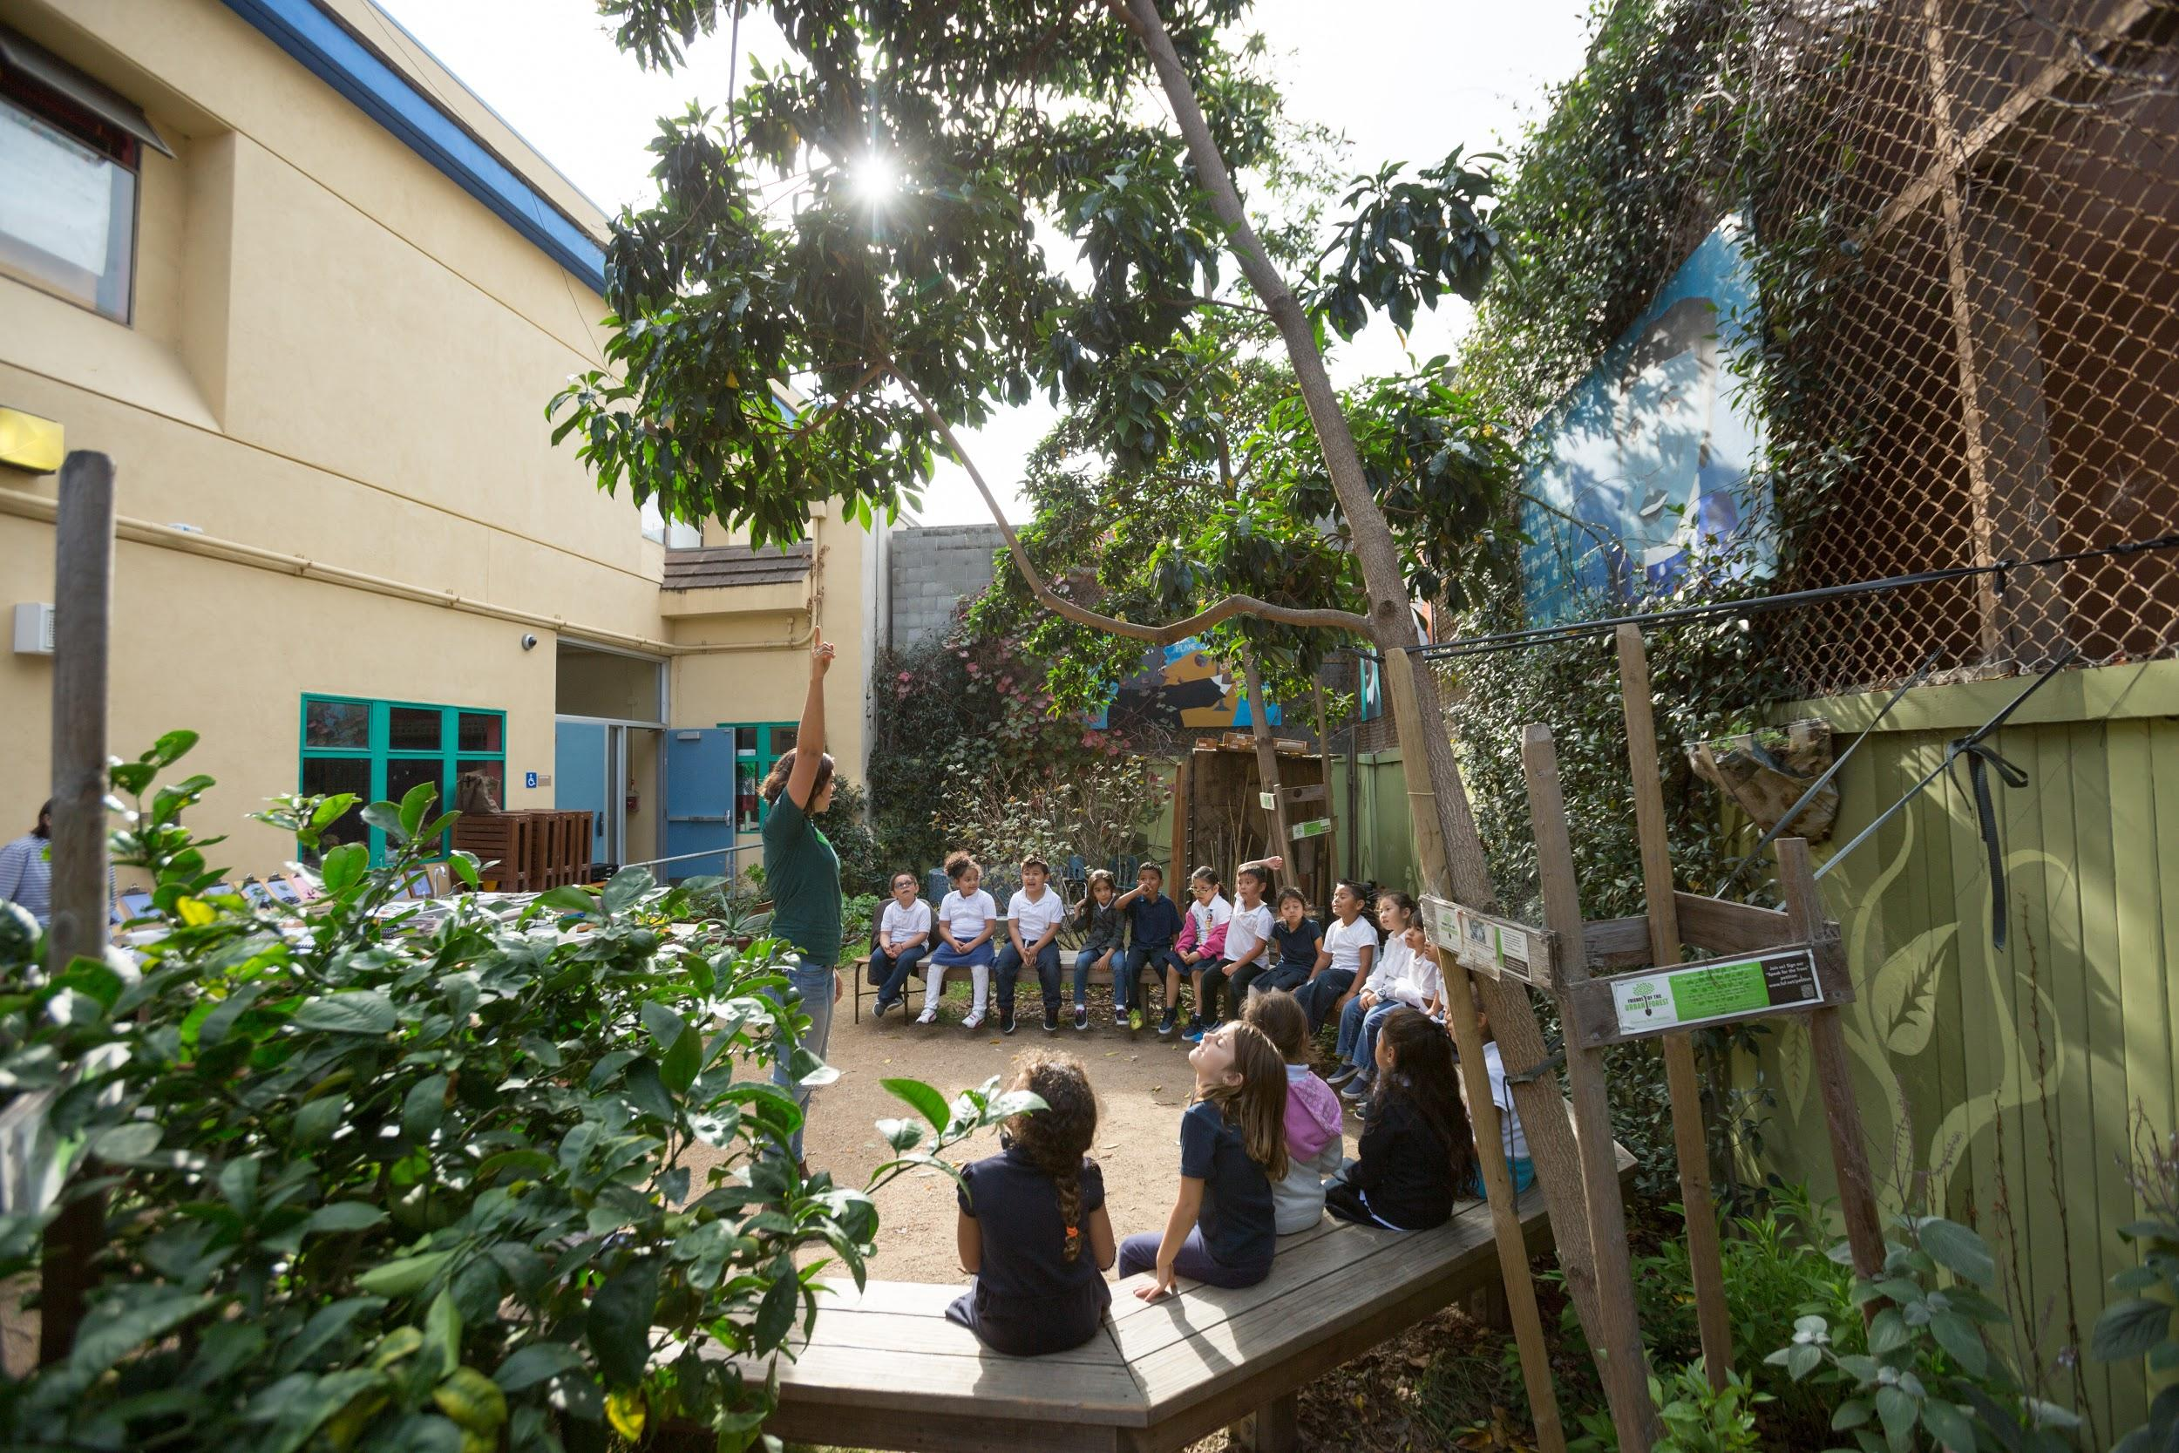
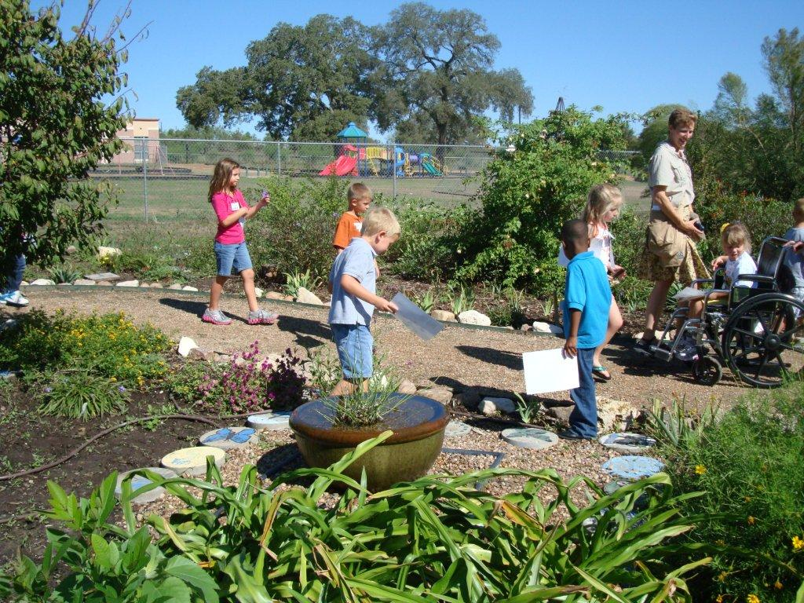
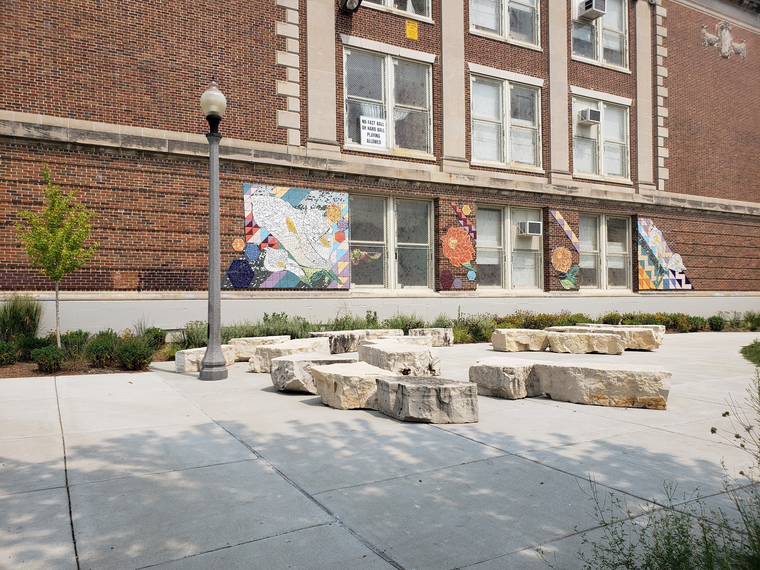
Green schoolyard programs across the U.S.
Notes:
-To give you an idea of what is happening around the country, here is a snapshot of cities and school districts who are implementing green schoolyard programs.

Slide 14
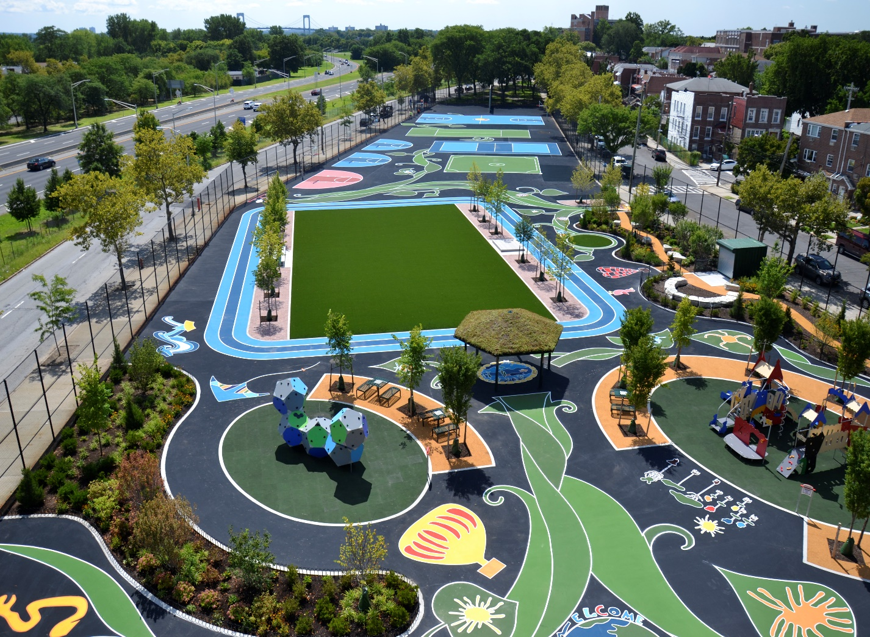

The #NYCPlaygroundsProgram
High Level Impacts:
200 playgrounds across NYC’s five boroughs
4 million New Yorkers within a 10-minute walk
18.5 Million gallons of storm water captured every year
Notes:
-Trust for Public Land began transforming schoolyards in New York City in 1996 to meet park walkability goals.
-After NYC passed their Green Infrastructure Plan, the program has evolved to include stormwater capture and receives funding to create more green components from the Department of Water.
-The program has already transformed almost 200 schoolyards in NYC

Slide 15

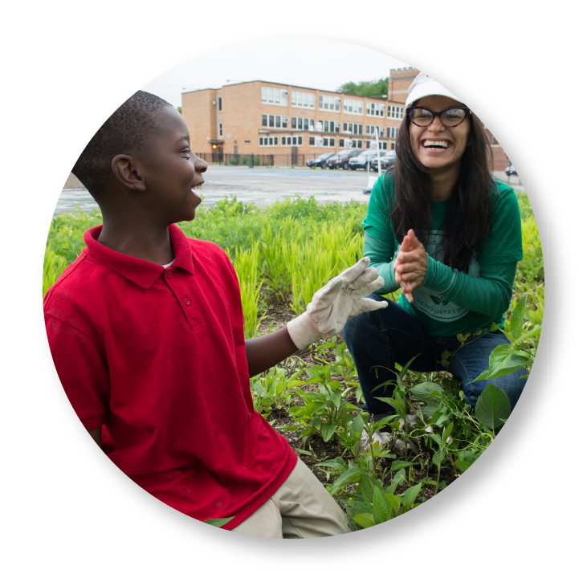
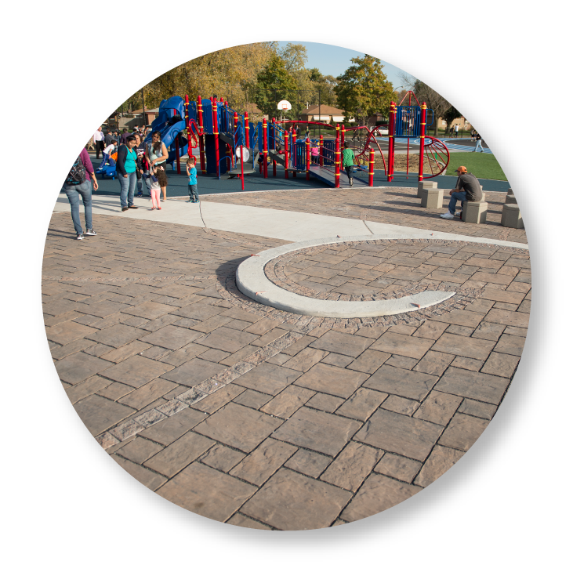
Space to Grow transforms Chicago schoolyards into vibrant spaces to play, learn and be outside.
Health + Wellness
Outdoor Learning
Stormwater Management
Notes:
-Since 2014, Space to Grow has transformed 13 elementary school campuses in Chicago Public Schools.
-The partnership includes two water agencies, Chicago Public Schools, and two coordinating non-profit partners, Openlands and Healthy Schools Campaign with shared goals of Health + Wellness, Outdoor Learning, and Stormwater Management.
-School community engagement in the design, installation, use and stewardship of the schoolyards is a key component of the program.

Slide 16

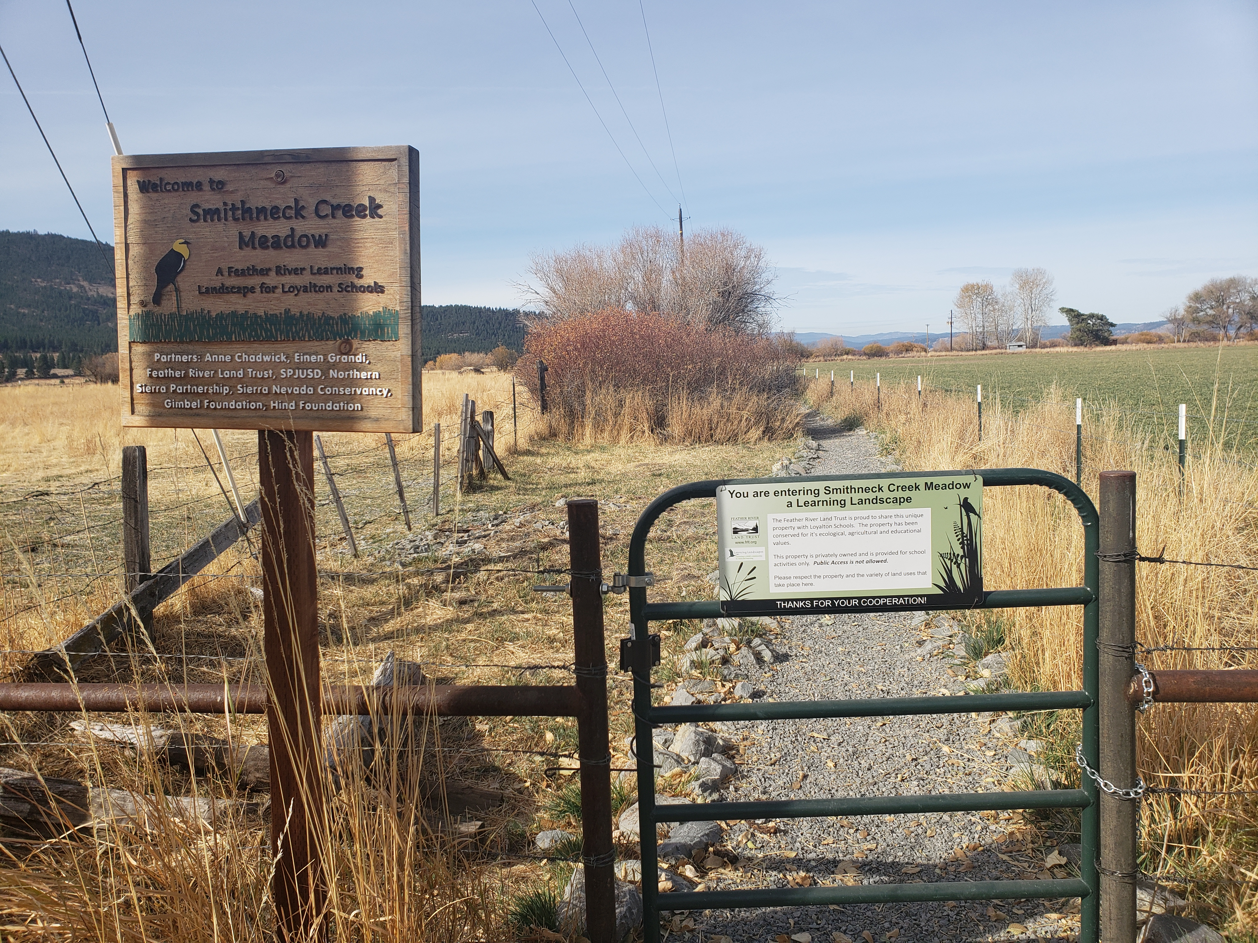
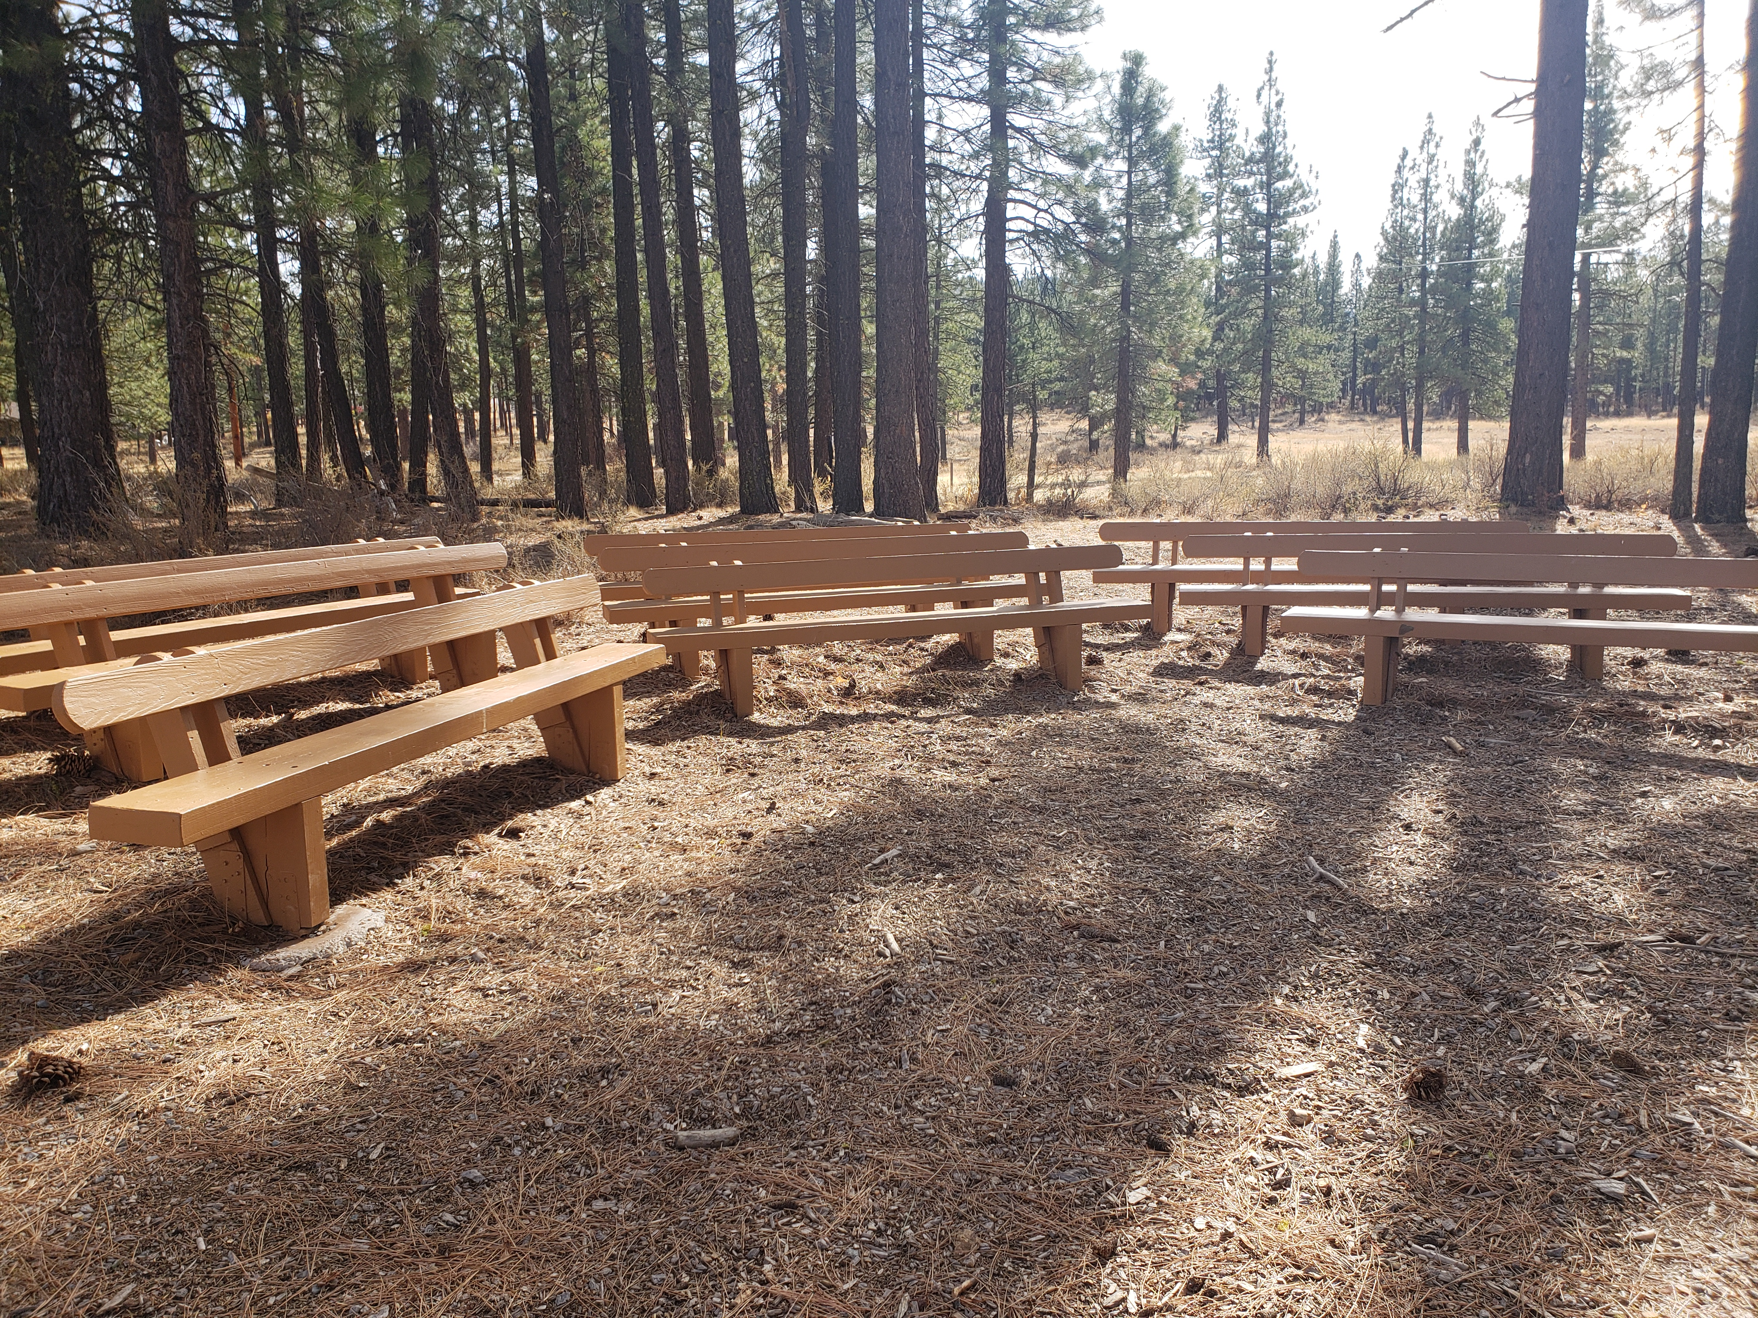
Notes:
-Founded in 2004 with a land trust and partners, Learning Landscapes serves the Upper Feather River Watershed, which is comprised of 18 schools (K-6, 7-8, 9-12 in each community), in six communities in three different districts (Plumas Unified, Westwood Unified, Plumas-Sierra Joint Unified) and three counties (Plumas, Lassen, Sierra), serving nearly 3000 schoolchildren annually.
-A rural green schoolyards program, Learning Landscapes takes advantage of preserved adjacent property and develops school grounds with trails, outdoor classroom areas and native plantings. The program supports the use of these spaces as an extension of the classroom.

Slide 17
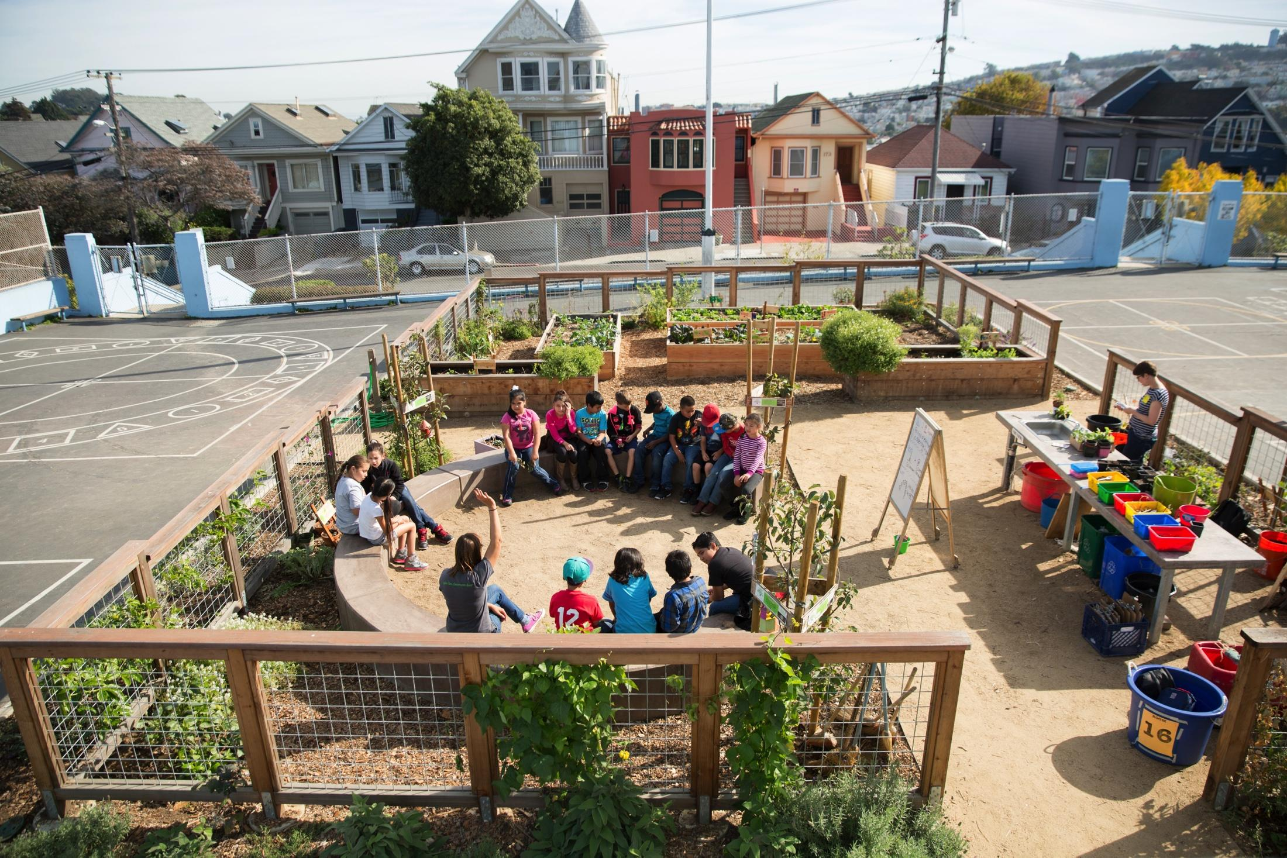


We create students who:
-are excited by and engaged in DOING science
-have an enduring bond with the natural world
Notes:
-The goal of Education Outside is to bring hands-on, experiential science and environmental education to every SFUSD public elementary school student as a part of the regular school day, throughout the school year.
-From 2001 through 2011 the San Francisco Unified School District secured nearly $14 million in city bond funding to design and construct green schoolyards at 84 public schools throughout San Francisco.

Slide 18

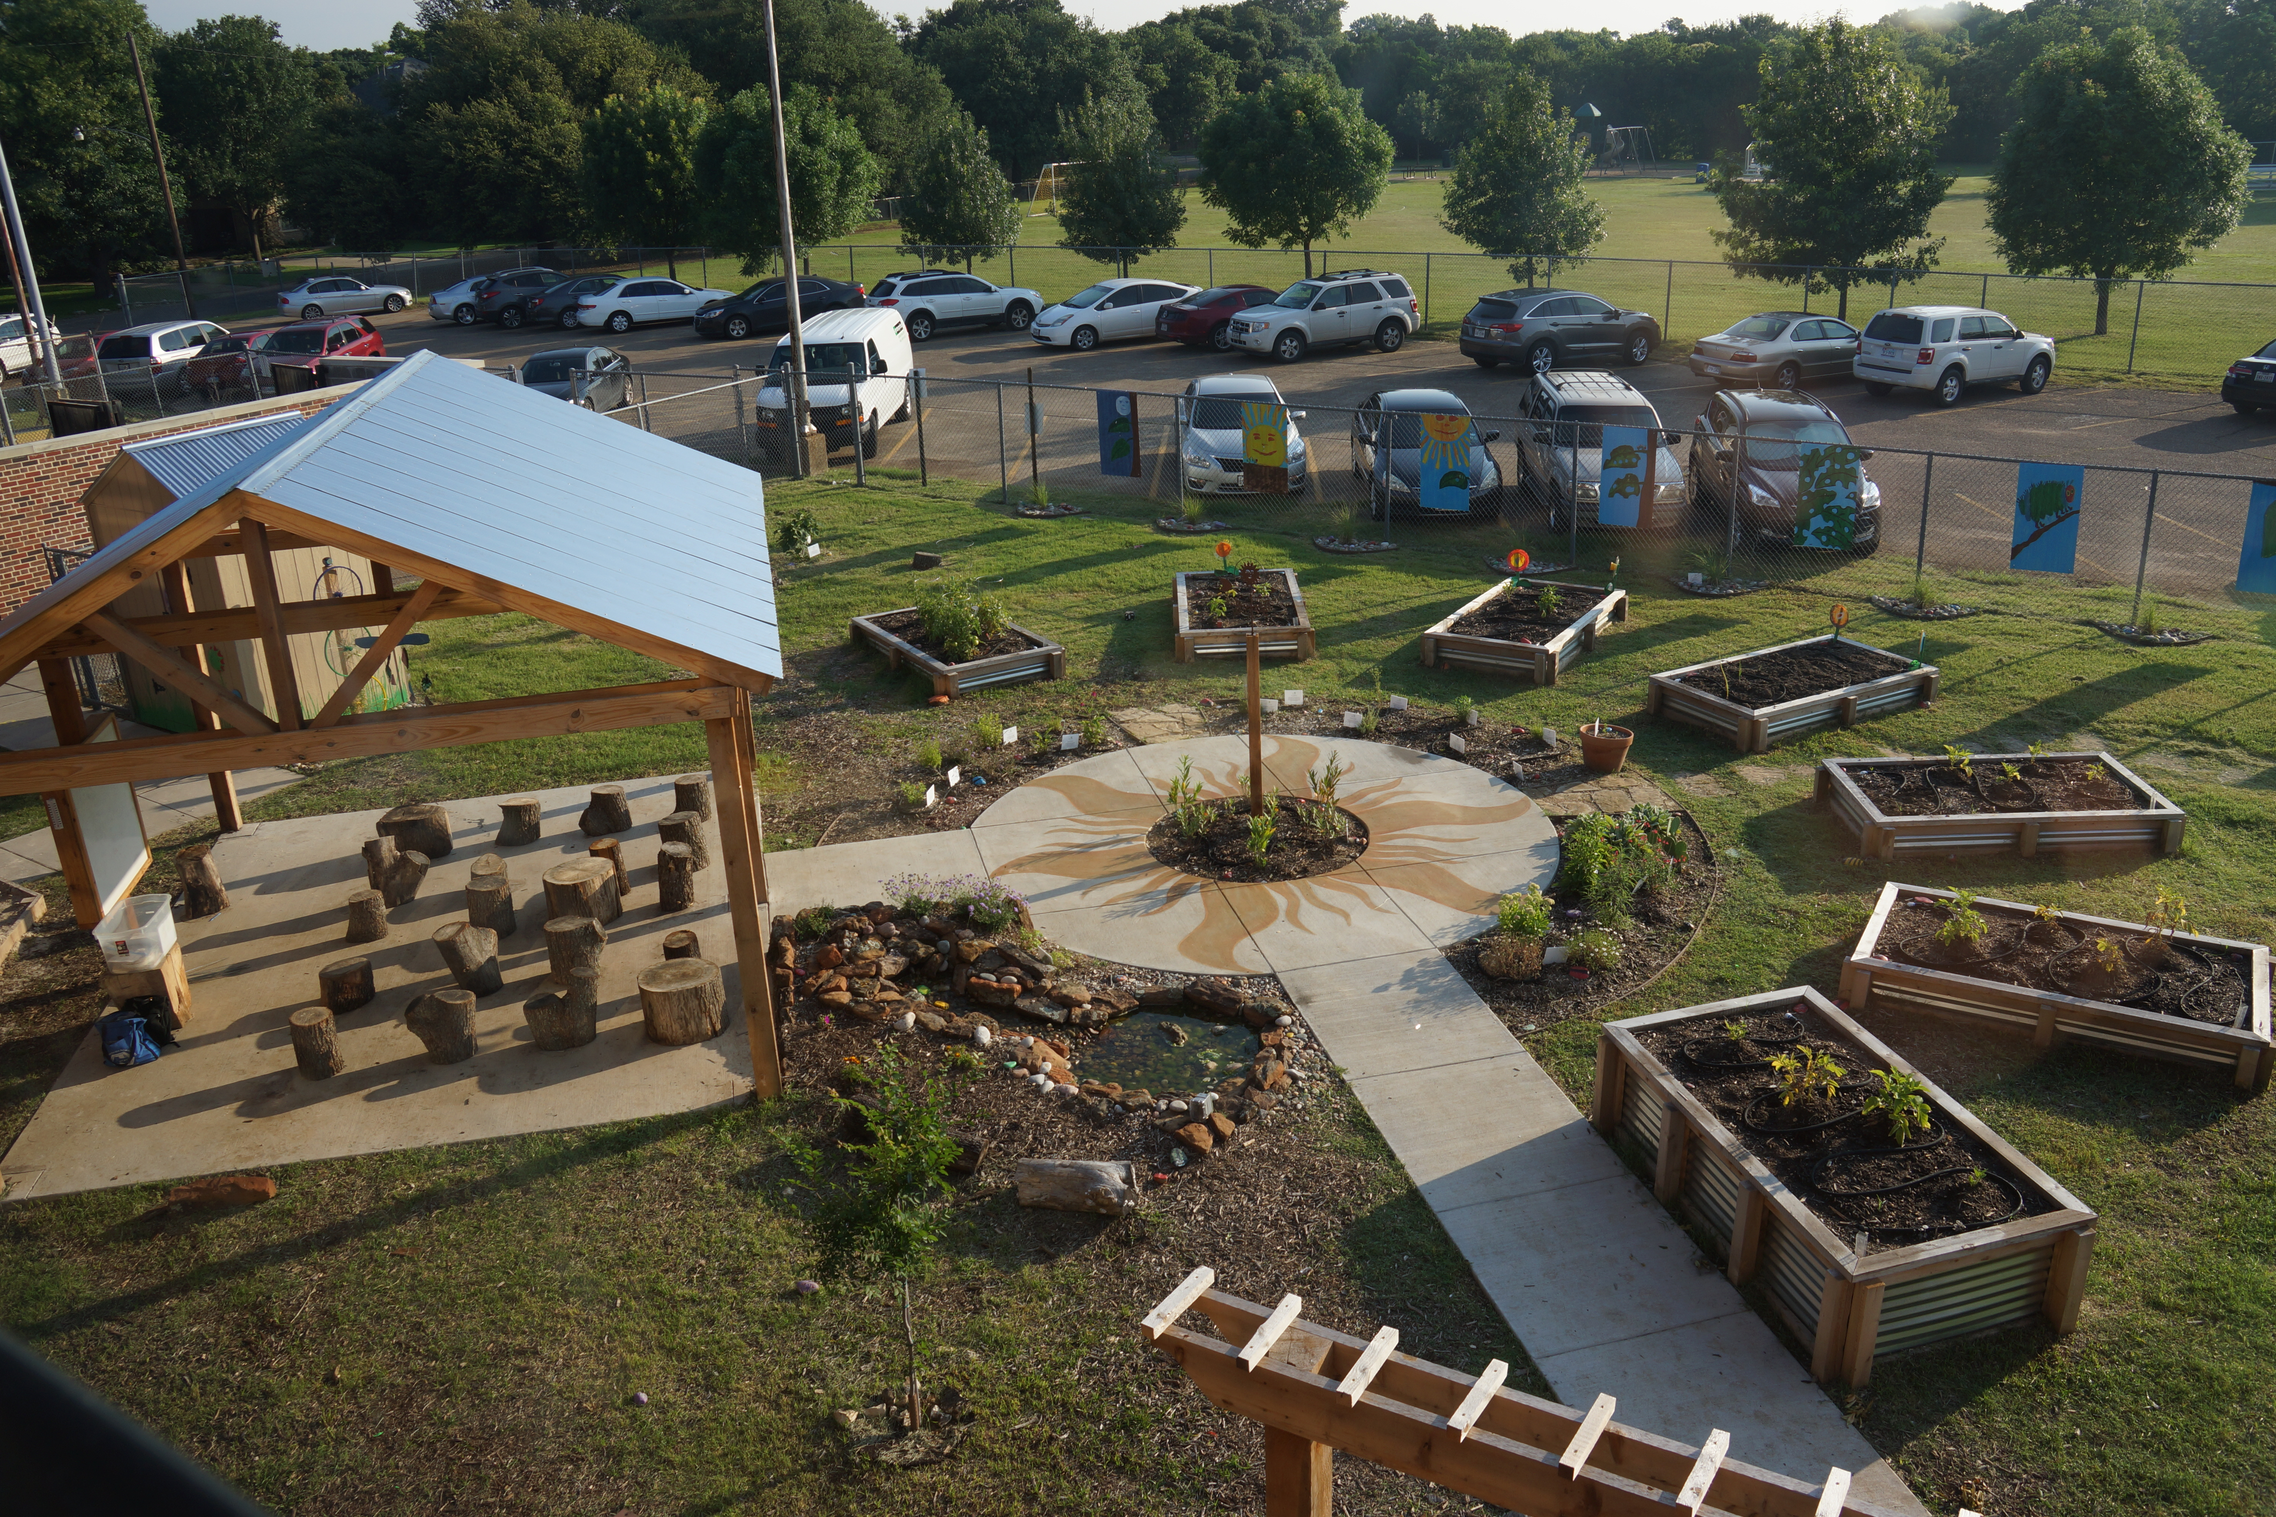
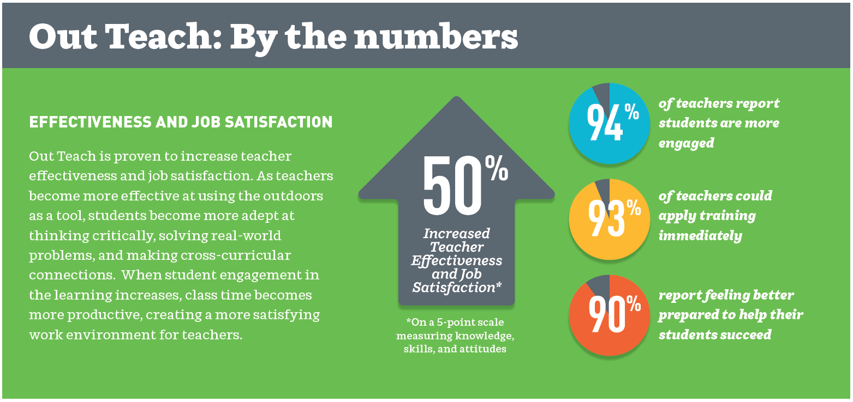
Unlocking Student Performance
By combining our field-tested professional learning program with exciting outdoor learning labs, Out Teach equips elementary school teachers to go outside—beyond the classroom—to create transformational learning experiences and measurable results.
For more, visit out-teach.org or email info@out-teach.org
Notes:
-Out Teach provides professional development, mentoring and modeling for schools with outdoor classrooms. Their program is highly successful and improves teacher and student motivation.
-Out Teach provides job-embedded coaching to transform teacher practice with field-tested outdoor experiential lessons that improve outcomes for students and help achieve learning standards.
-The organization currently serves 115 schools, 4,000 teachers, and 80,000 students. Out Teach has grown from a single location to a regional model that now includes Texas, the Mid-Atlantic, the Carolinas, and the Southeast, with plans to grow to 15 cities in five regions by 2023 and a goal of serving 15,000 teachers and 200,000 students annually.

Slide 19
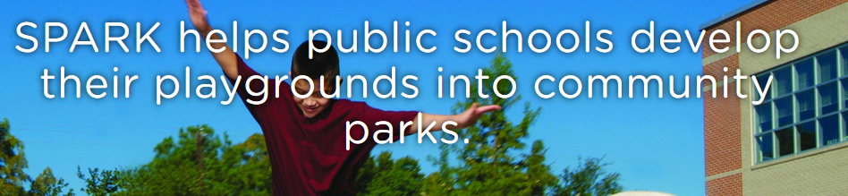

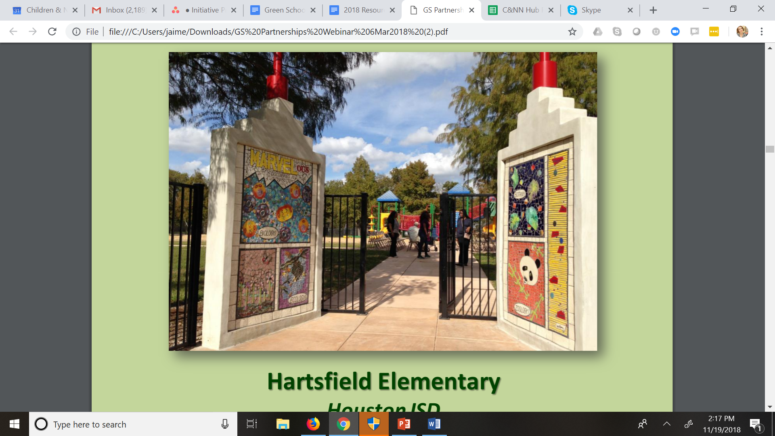
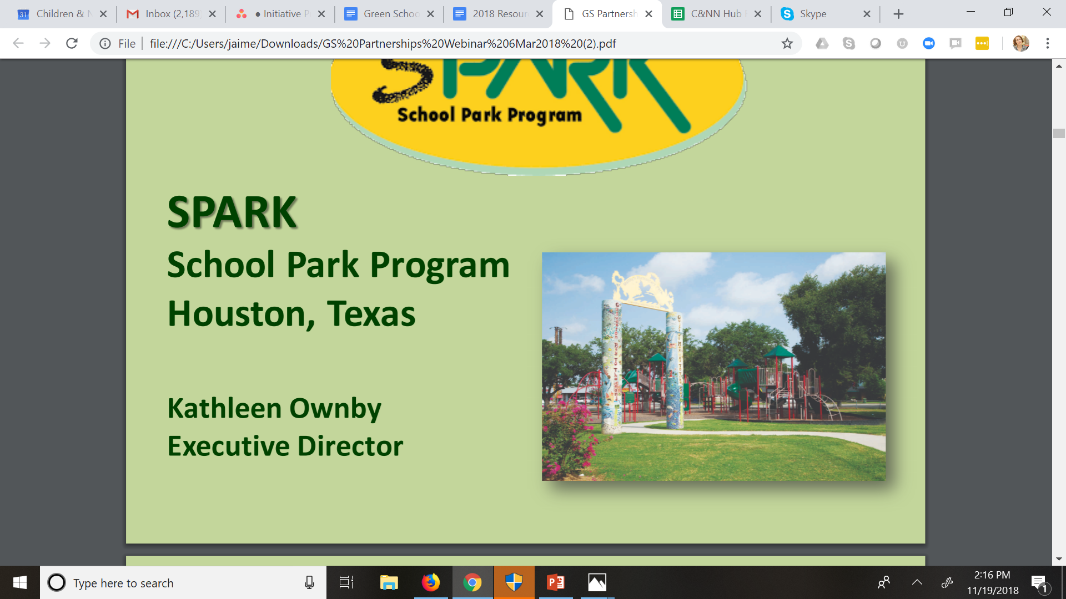
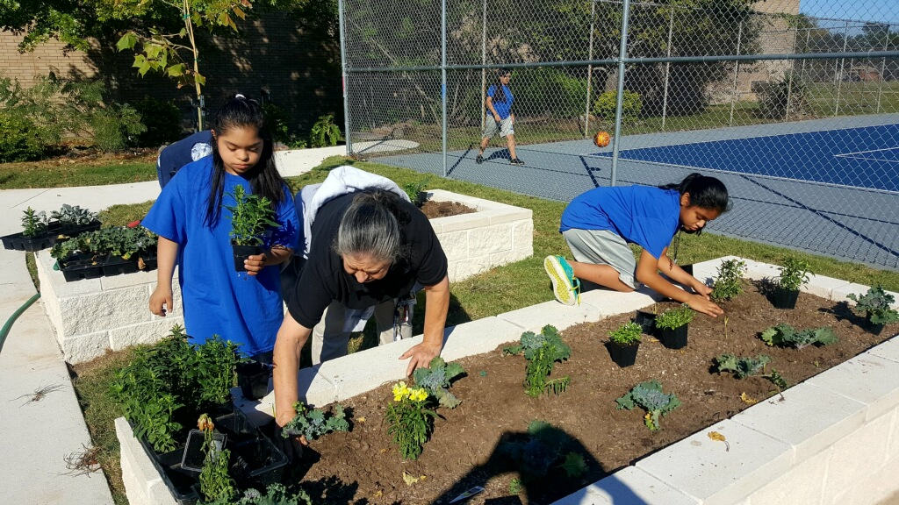
Houston, TX
Notes:
-In Houston, TX, In the past 30 years, SPARK has built over 200 community parks in 17 school districts in Harris County, Texas, including those being created in park deserts where no parks exist.

Slide 20
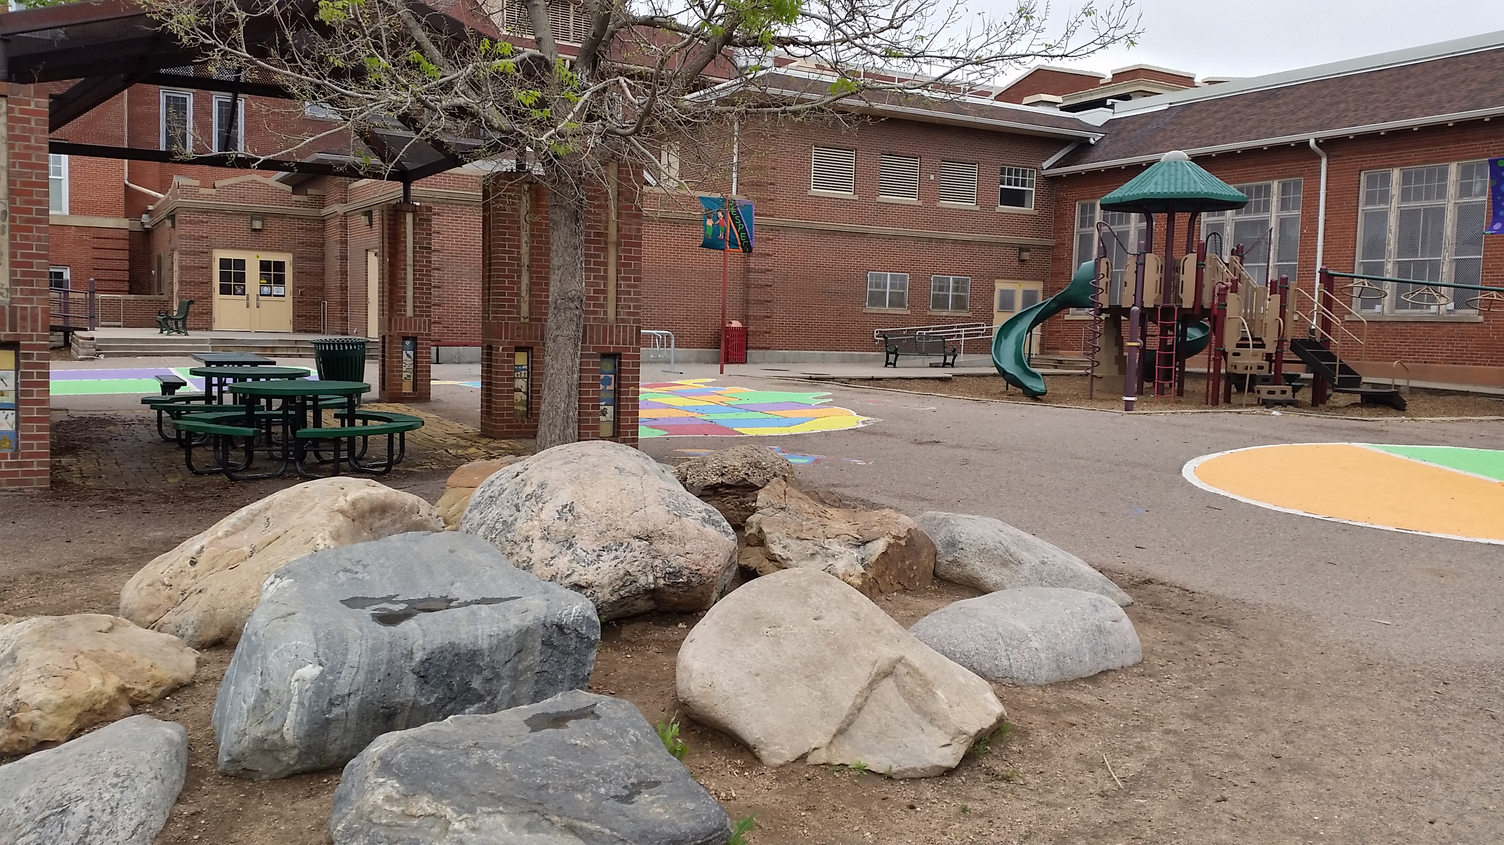
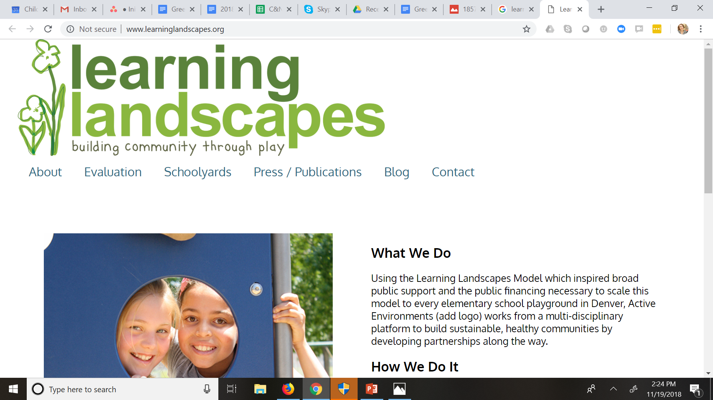
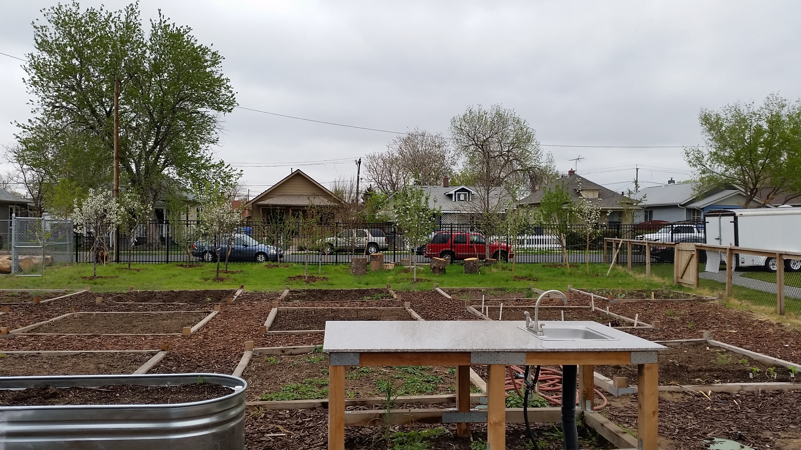
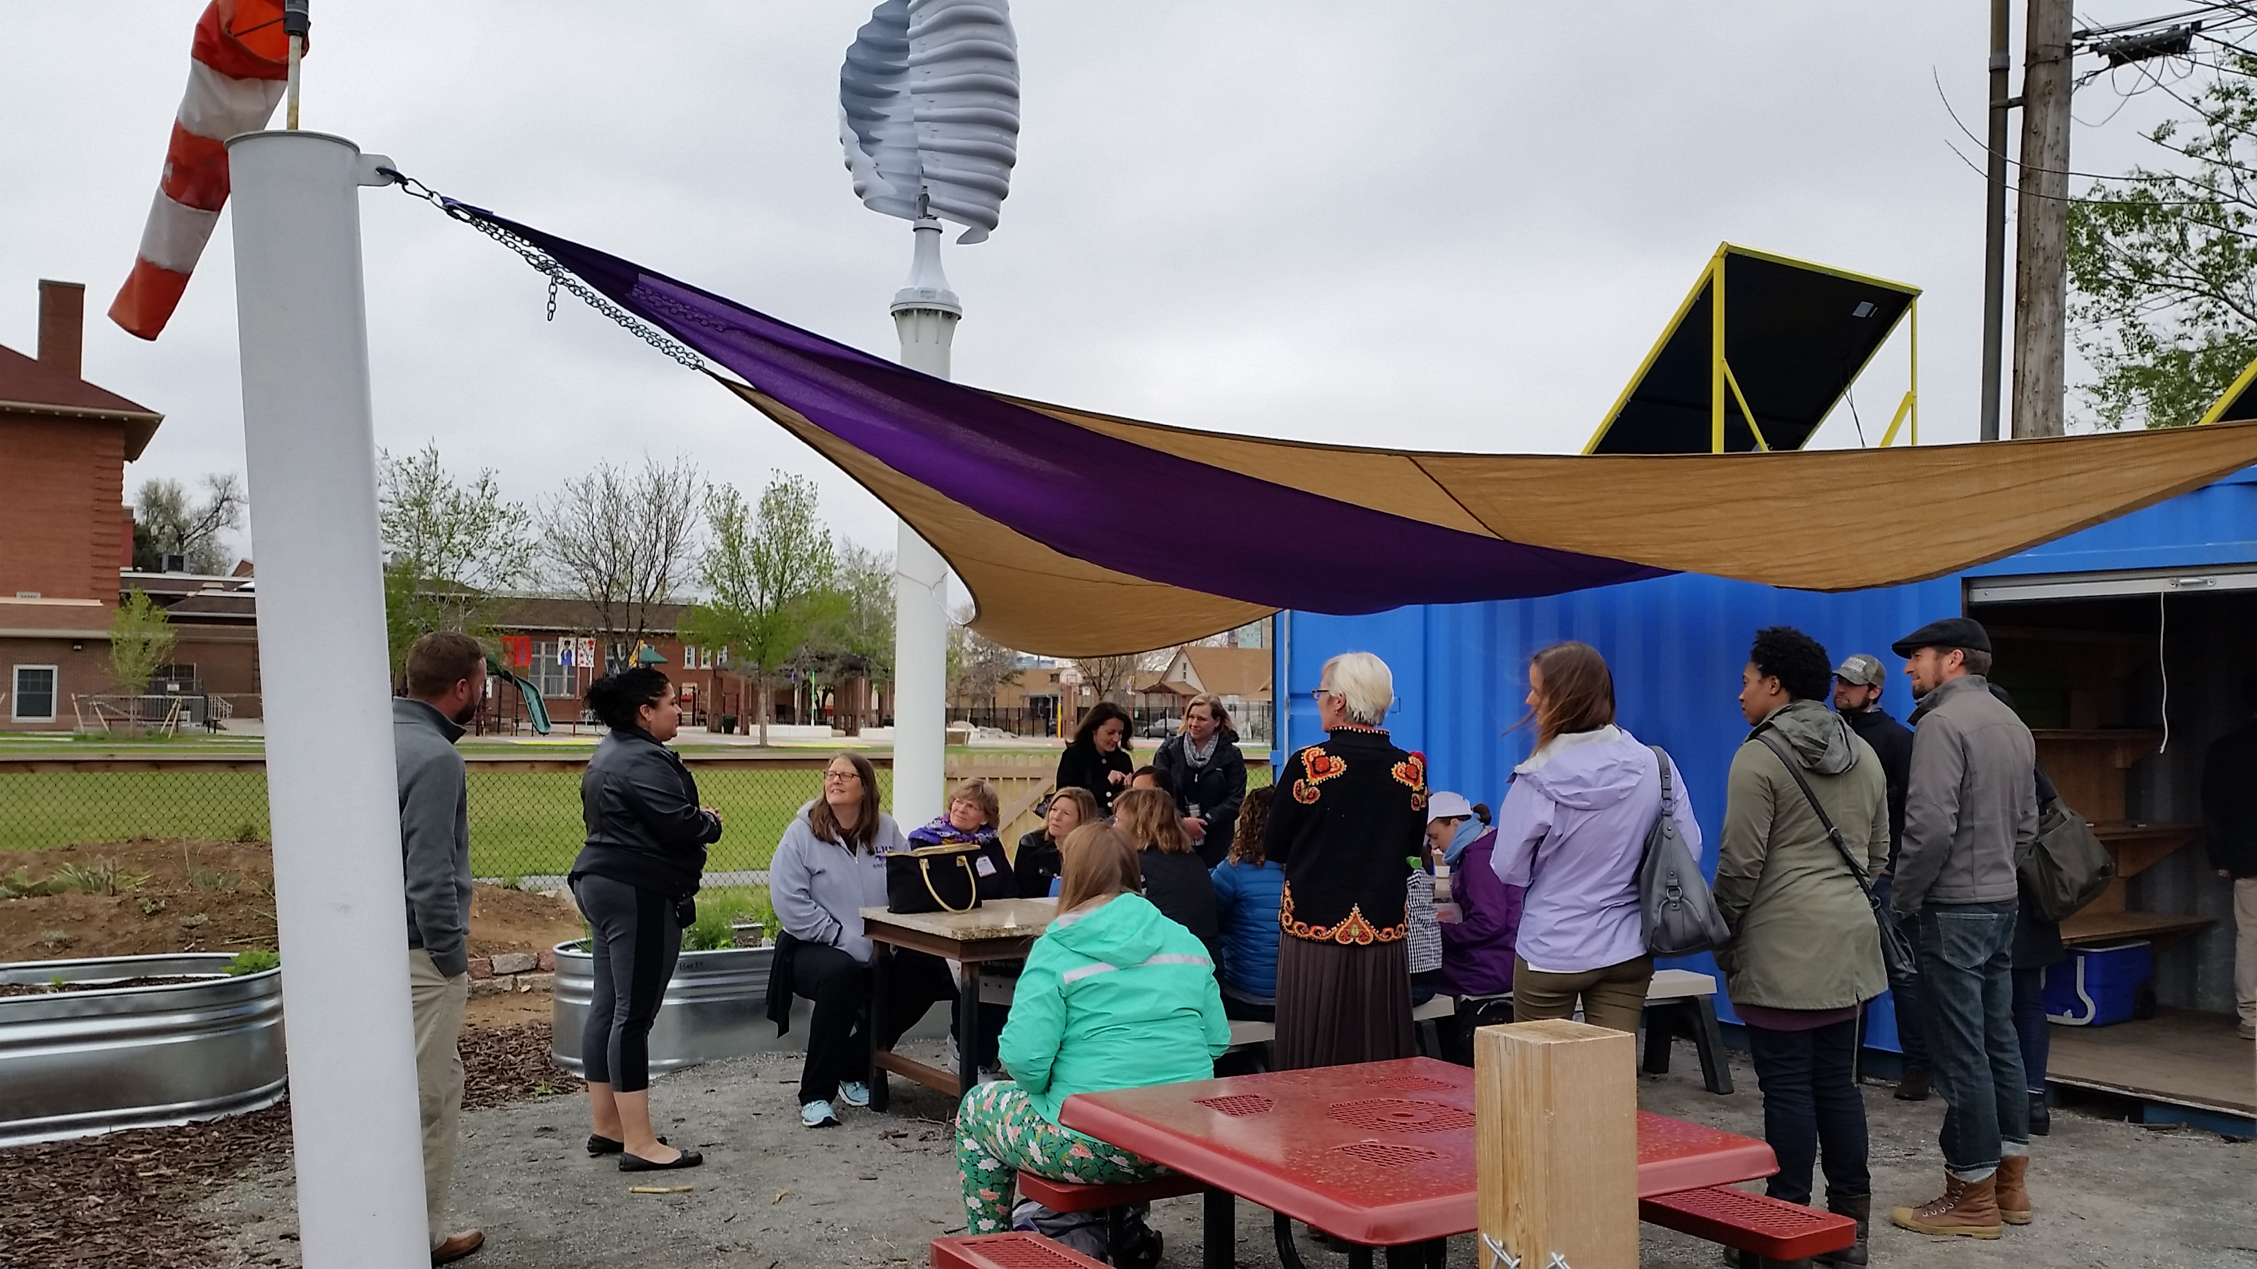
Denver, CO
Notes:
-Learning landscapes was founded in 2003, and in less than 15 years, transformed all 96 elementary school campuses in Denver Public Schools with Community Development Block Grant Funds and municipal bonds.
-Participatory landscapes that support outdoor learning with academic and physical education and socialization tools for school-age children.

Slide 21

More information
Green Schoolyards Resource Hub
Notes:
-See the C&NN Green Schoolyards Resource Hub to find out more about every step of the green schoolyards program development process with resources created by programs across the country.

